Slide 1
Data Flow Diagram
(DFD)

Slide 2
What is a Data Flow Diagram?
A data flow diagram (DFD) is a graphical tool that allows system analysts (and system users) to depict the flow of data in an information system.
The DFD is one of the methods that system analysts use to collect information necessary to determine information system requirements.

Slide 3
What is a Data Flow Diagram?
A Data Flow Diagram is intended to serve as a communication tool among
  systems analysts
  end users
  data base designers
  system programmers
  other members of the project team

Slide 4
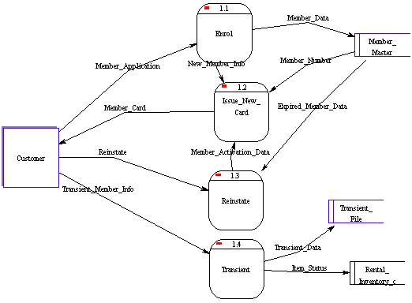
What does a DFD look like?

Slide 5
DFD Symbols and Definitions
Process - performs some action on data, such as creates, modifies, stores, delete, etc. Can be manual or supported by computer.
Data store - information that is kept and accessed. May be in paper file folder or a database.
External entity - is the origin or destination of data. Entities are external to the system.
Data flow - the flow of data into or out of a process, datastore or entity
Process
Data store
External
Entity
Data flow
Notes:
14

Slide 6
Rules for Drawing DFD’s
A minimum of one data flow
in and one data flow out of
a process
A datastore must be
connected to a process
(either in, out, or both)
An external entity must
be connected to a process
(either in, out, or both)
A single data flow must
only flow one way
Notes:
16

Slide 7
DFD: Common Mistakes
Process has no data flowing into it, but has data flowing out.
Data store is hooked to external entity. This means external entity can read and write to your data file without auditing!!
The data flow goes in two directions at once. Two or more arrows should be used to show the flow to and from each process.

Slide 8
DFD Example 1
The Broadway Entertainment Company
  An important first step to consider is to look at the key processes under study. These can be itemized into a hierarchical series, where the highest level (level 0) describes a general department, or business unit, to the lowest level. The lowest level is a point where you cannot break a process into any more divisible components. These are referred to as functional primitives.
Notes:
17

Slide 9
DFD: Adding Levels of Detail
The highest level, called the context diagram, is only an overview. More detail is typically needed for system analysts.
We add detail to a DFD by creating “levels”. The first level added after the context diagram is called level “0”.
Each new level breaks apart one process and “decomposes” the single process into a new, more detailed DFD. A complete DFD can have many (up to 6 or 7) levels depending on the complexity of system.
Breaking the DFD into levels is referred to as “Decomposition”.

Slide 10
DFD: Numbering Levels
In a DFD with many levels it’s easy to forget which level you are on. That’s why each level has different numbering for the processes on the diagram. The ‘level’ corresponds to the number of decimal places required to define a process in it. Here’s how it works:
  Context Diagram Process labeled “0”
  Level 0 Processes labeled 1.0, 2.0, 3.0, .
  Level 1 Processes labeled 1.1, 1.2, 1.3, .
  Level 2 Processes labeled 1.11, 1.12,...

Slide 11
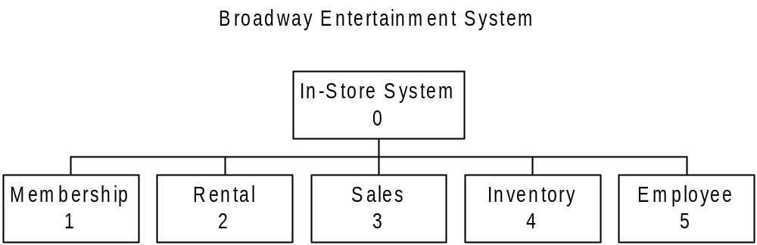
Top (0) Process Level

Slide 12
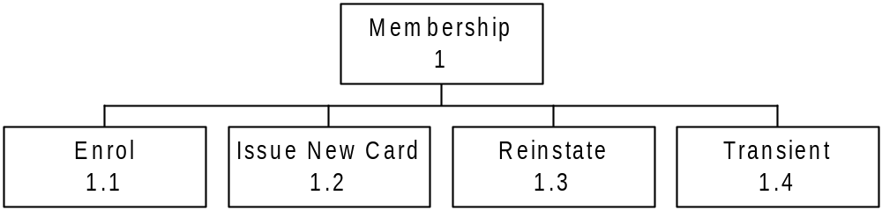
Level 1: Membership

Slide 13
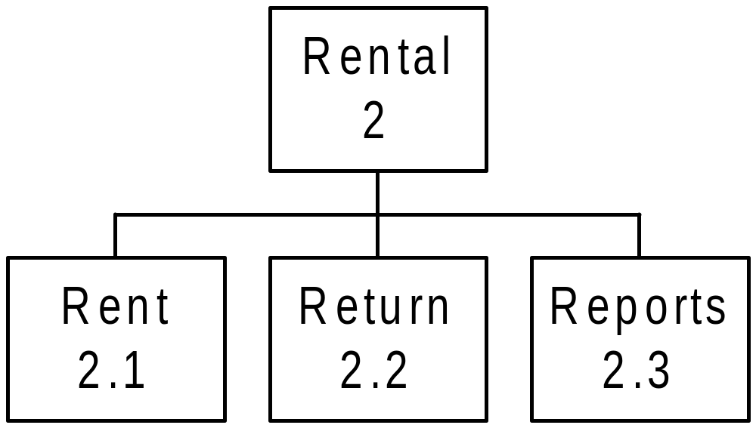
Level 1: Rental
(note this is the primitive level for this series of processes)

Slide 14
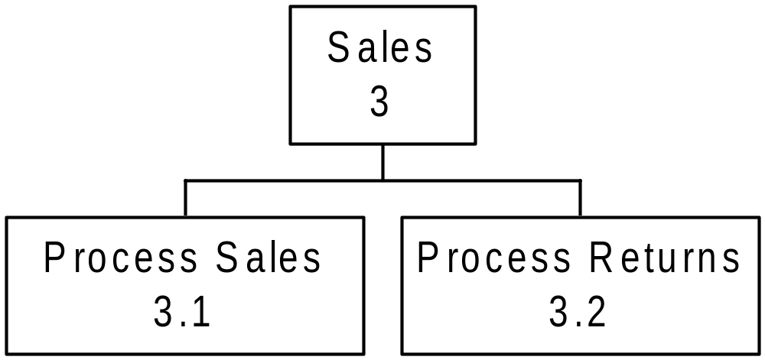
Level 1: Sales

Slide 15
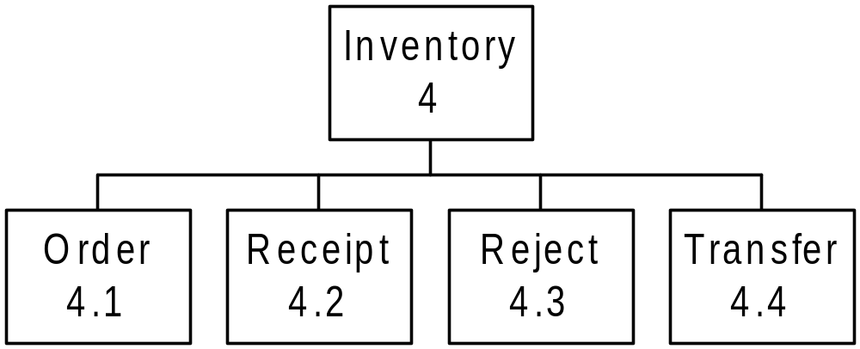
Level 1: Inventory

Slide 16
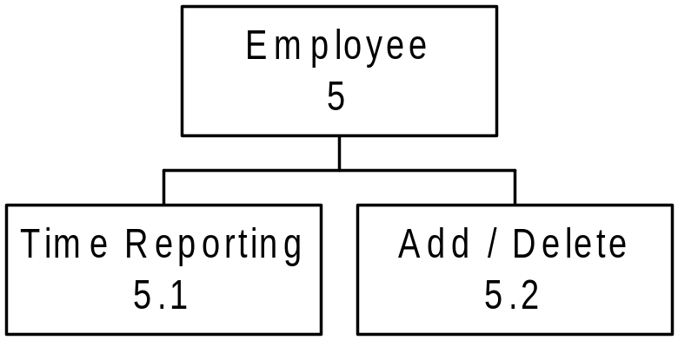
Level 1: Employee

Slide 17
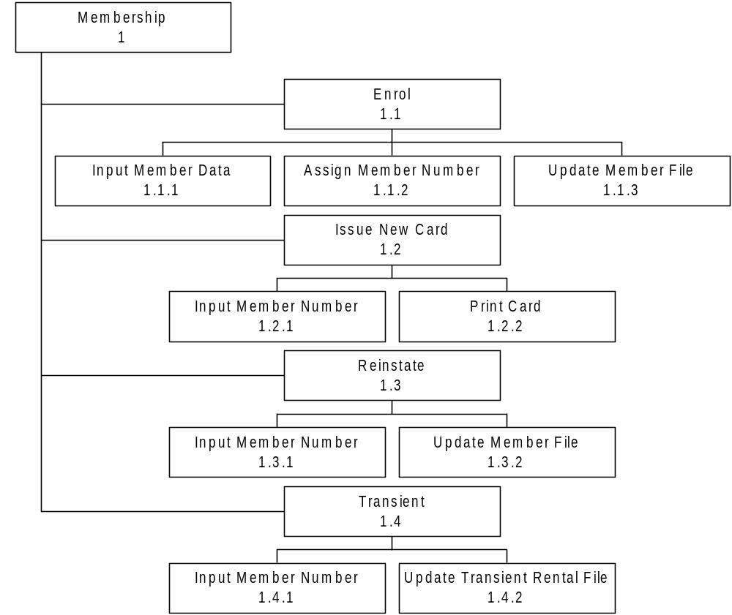
Level 2: Membership

Slide 18
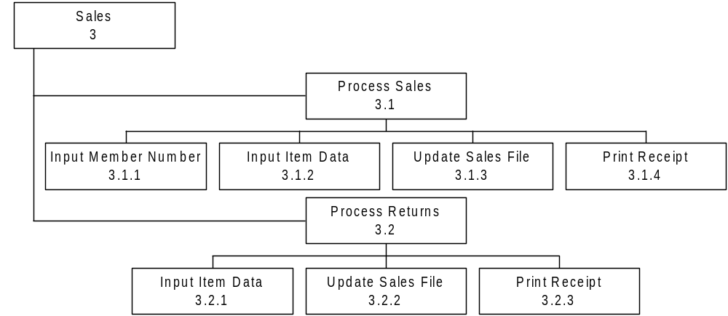
Level 2: Sales

Slide 19
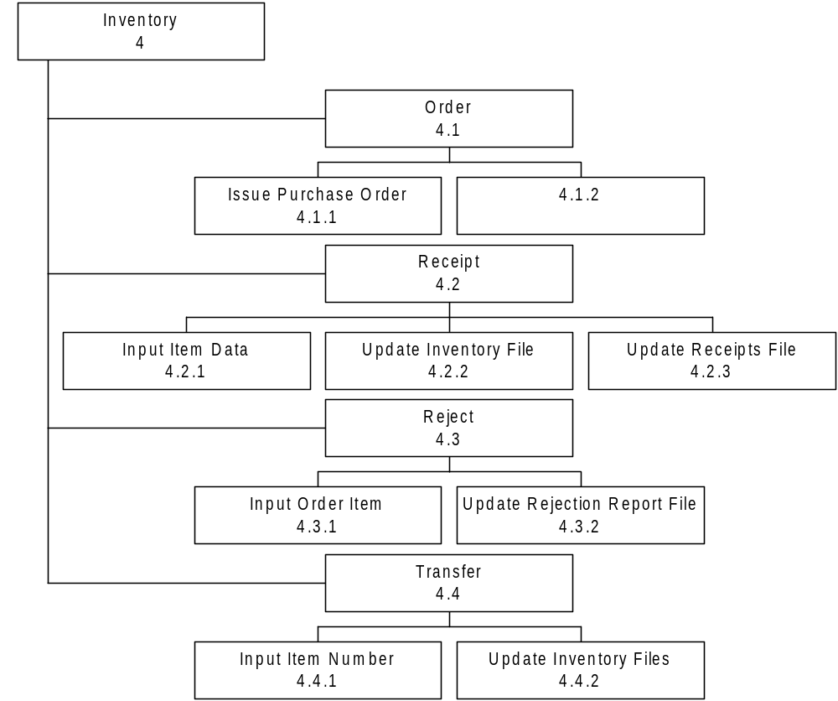
Level 2: Inventory

Slide 20
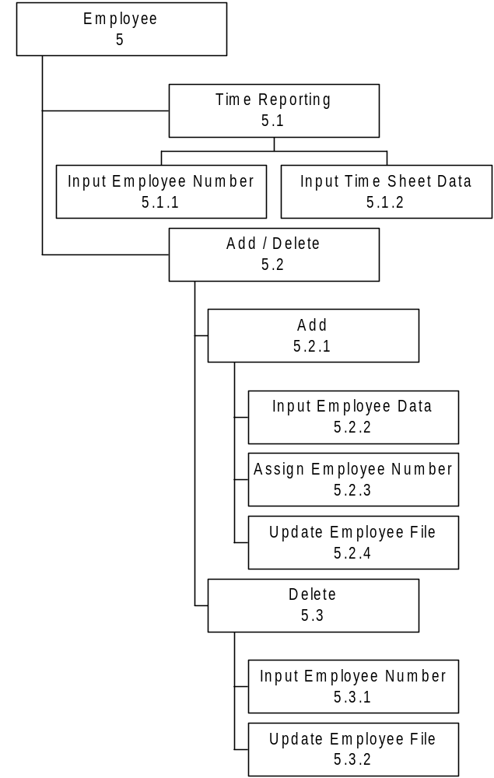
Level 2: Employee

Slide 21
DFD Levels: Context Diagram
First we can start to draw a general overview. This general overview is called a “Context Diagram”.
A Context Diagram shows three things:
  all external entities
  a single process labeled “0”that represents the entire system (food ordering system)
  the major information flows between the external entities and the system.

Slide 22
DFD: Logical vs Physical
Note that the Context Diagram did NOT record the movement of merchandise, but rather the information flow surrounding the underlying business processes.
  A DFD that shows the movement of information is called a “logical” DFD.
  A DFD that shows the movement of physical stuff (such as merchandise) is called a “physical” DFD.
The logical DFD is by far the most common type of DFD and therefore we will focus on this in this class.

Slide 23
DFD for Broadway
Corresponding to the Process Structure Charts previously outlined, Broadway’s DFD can be drawn as per the following charts:

Slide 24
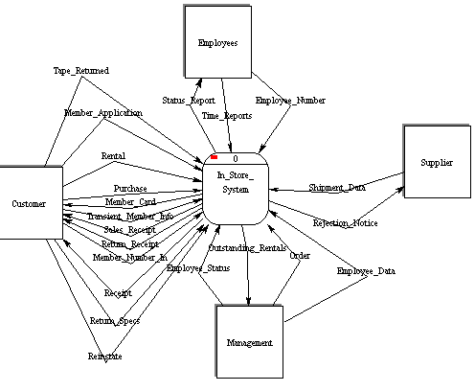
Context Level
(note there are no storage elements at this level)

Slide 25
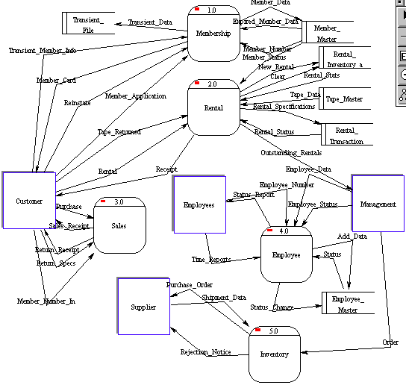
Level 0

Slide 26
Activity Diagrams
in UML

Slide 27
Definition
Activity diagrams represent the dynamics of the system.
They are flow charts that are used to show the workflow of a system.
They show.
  The flow of control from activity to activity in the system,
  What activities can be done in parallel.
  Alternate paths through the flow.
They can show the flow across use cases or within a use case.

Slide 28
Activity Diagram
Core symbol is an activity.
An activity is some task which needs to be done.
Each activity can be followed by another activity (sequencing).
Triggers from the activity may be guarded as in state diagrams.

Slide 29
Decision Activities
Diamond.
Each trigger coming from it has a guard.
Synchronisation bar.
All triggers from this attach to activities that can occur in parallel, with no specific sequence, or concurrently.
The next synchronisation bar closes the concurrency.
Iteration is represented by a * on the trigger.
or

Slide 30
Find
Beverage
[no coffee]
[no cola]
[found coffee]
Put coffee
in filter
Add water
to reservoir
Get
cups
Get can
of cola
Put filter
in machine
Turn on
machine
Brew
coffee
Pour
coffee
Drink
Beverage

Slide 31
Activity Diagram for Receiving an Order
Receive
order
* for each line
item on order
Authorise
Payment
Check line
item
[failed]
[in stock]
Cancel
Order
[succeeded]
Assign
to Order
[need to reorder]
Reorder
item
[stock assigned
to all line items
and payment
authorised]
Dispatch
Order

Slide 32
Activity Diagram for receiving Supply
Receive
Supply
Choose outstanding
order items
* for each chosen order item
Assign goods
to order
[all outstanding order items filled]
Add remainder
to stock
Dispatch
Order

Slide 33
Combined Activity Diagram
Receive
order
Receive
Supply
* for each line
item on order
Choose
outstanding
order items
Check line
item
Authorise
Payment
[failed]
[in stock]
* for each chosen order item
[succeeded]
Assign
to Order
Assign goods
to order
Cancel
Order
[need to reorder]
Reorder
item
[stock assigned
to all line items
and payment
authorised]
[all outstanding order items filled]
Dispatch
Order
Add remainder
to stock

Slide 34
With Swimlanes
Finance
Order
Processing
Stock
Manager
Receive
order
Receive
Supply
* for each line
item on order
Choose
outstanding
order items
Check line
item
Authorise
Payment
[failed]
[in stock]
* for each chosen order item
[succeeded]
Assign
to Order
Assign goods
to order
Cancel
Order
[need to reorder]
Reorder
item
[stock assigned
to all line items
and payment
authorised]
[all outstanding order items filled]
Dispatch
Order
Add remainder
to stock

Slide 35
Finish diagram
Connect all elements on the diagram with transitions.
Place decisions on the diagram where the workflow may split into an alternate flow.
  E.g. based on a Boolean expression, the workflow could branch to a different workflow.
Evaluate your diagram and see if you have any concurrent workflows. If so, use synchronizations to represent forking and joining.
Set all actions, triggers and guard conditions in the specifications of each model element.

Slide 36
Component Diagrams
Structural Diagrams
  Class;
  Object
  Component
  Deployment
  Composite Structure
  Package

Slide 37
Component Diagram
UML1.x – implementation view
Shows a set of components and their relationships.
Represents the static implementation view of a system.
Components map to one or more classes, interfaces, or collaborations.
Mapping of Components into Classes
Components and their Relationships
loanOfficer.dll
component
Registrar.exe
LoanOfficer
CreditSearch
Course.dll
LoanPolicy
Student.dll
classes
Notes:
See UML text pg. 347 (figure 25-3) for an example.

Slide 38
Component Diagram
UML2.0 – architectural view
Big demand, hmm…
Short history behind architecture
Architecture still an emerging discipline
Challenges, a bumpy road ahead
UML and architecture evolving in parallel
Component diagram in need of better formalization and experimentation
Notes:
See UML text pg. 347 (figure 25-3) for an example.

Slide 39
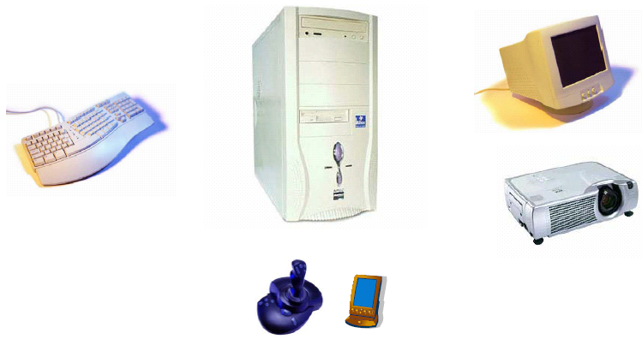
Component Diagram – another example
(www.cs.tut.fi/tapahtumat/olio2004/richardson.pdf)

Slide 40
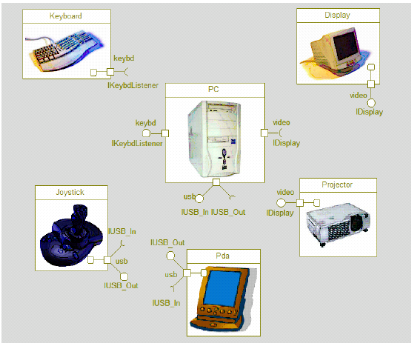
Component Diagram – another example
(www.cs.tut.fi/tapahtumat/olio2004/richardson.pdf)

Slide 41
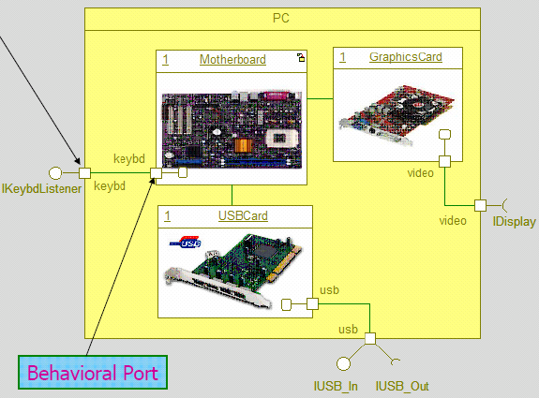
Component Diagram – another example
(www.cs.tut.fi/tapahtumat/olio2004/richardson.pdf)

Slide 42
Component Diagram
UML2.0 – architectural view
Explicit description of interfaces:
provided services to other components
requested services from other components
Component
lollipop
Component
socket
An interface is a collection of 1..* methods, and 0..* attributes
Interfaces can consist of synchronous and / or asynchronous operations
A port (square) is an interaction point between the component and its environment.
Can be named; Can support uni-directional (either provide or require) or bi-directional (both provide and require) communication; Can support multiple interfaces.
possibly concurrent interactions
fully isolate an object’s internals from its environment
caller or callee?
security
AccessControl
StudentAdministration
Student
Encription
Incoming signals/calls
Persistence
Outgoing signals/calls
StudentSchedule
Data[1..*]
DataAccess
Notes:
See UML text pg. 347 (figure 25-3) for an example.

Slide 43
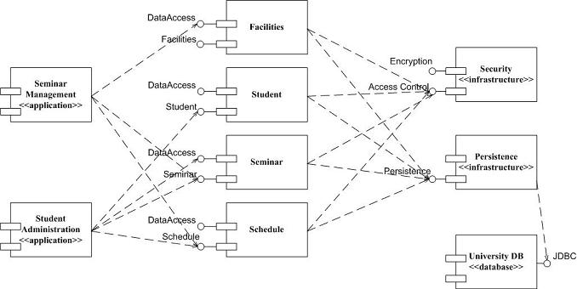
Component Diagram: UML 1.x and UML 2.0
(http://www.agilemodeling.com/artifacts/componentDiagram.htm)

Slide 44
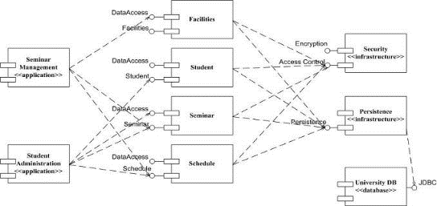
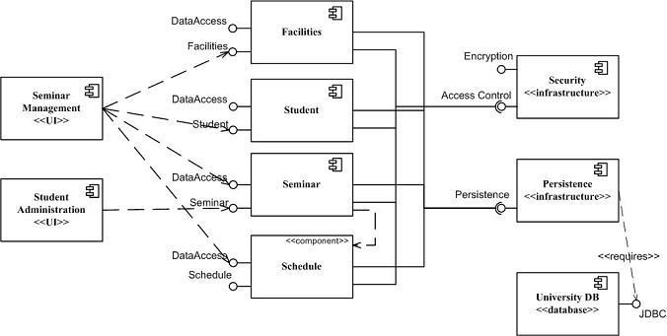
Component Diagram: UML 1.x and UML 2.0
(http://www.agilemodeling.com/artifacts/componentDiagram.htm)
So, how many different conventions for components in UML2.0?

Slide 45
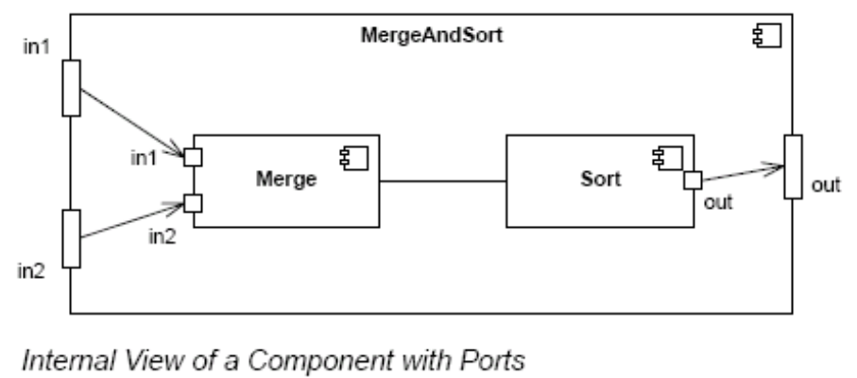
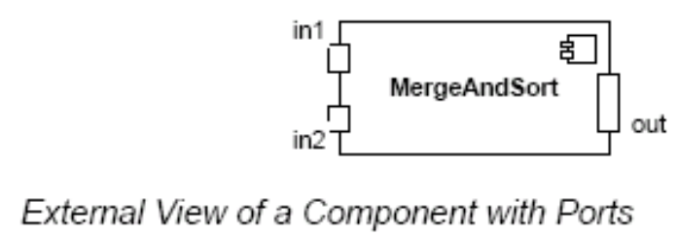
Component Diagram – Connector & Another Example
a connector: just a link between two or more connectable elements (e.g., ports or interfaces)
2 kinds of connectors: assembly and delegation. For “wiring”
  An assembly connector: a binding between a provided interface and a required interface (or ports) that indicates that one component provides the services required by another; simple line/ball-and-socket/lollipop-socket notation
  A delegation connector binds a component’s external behavior (as specified at a port) to an internal realization of that behavior by one of its parts (provide-provide, request-request).
delegation
delegation
assembly
connector
store
Left delegation: direction of arrowhead indicates
“provides”
So, what levels of abstractions for connections?
Right delegation: direction of arrowhead indicates
“requests”
Notes:
See UML text pg. 347 (figure 25-3) for an example.

Slide 46
Composite Structure Diagrams
Structural Diagrams
  Class;
  Object
  Component
  Deployment
  Composite Structure
  Package

Slide 47
Composite Structure Diagrams
(http://www.agilemodeling.com/artifacts/compositeStructureDiagram.htm)
Depicts the internal structure of a classifier (such as a class, component, or collaboration), including the interaction points of the classifier to other parts of the system.
Enroll in Seminar
Enroll in Seminar
applicant
Add to
Wait list
seminar
Student
prereq:
Seminar
Seminar
seats: Integer
waitList: Student
applicant
desired seminar
Student
prereq:
Seminar
Seminar
seats: Integer
waitList: Student
Determine
Seat
availability
Determine
eligibility
Enroll
existing
students
applicant
desired seminar
constrainer
registration
Course
req: Course
Enroll
Enrollment
constrainer
registration
Course
req: Course
<<refine>>
desired course
Enrollment
structured class, structured component, structured use case, structured node, structured interface, …

Slide 48
Variations [Rumbaugh – UML 2.0 Reference: p234]
collaboration name
Sale
role name
role
buyer: Agent
seller: Agent
role type
item: Property
Collaboration definition
collaborating object
Edward: Architect
Bala: Analyst
buyer
seller
role name
ShiloPurchase: Sale
use name
collaboration name
item
Shilo: Land
Collaboration use in object diagram

Slide 49
